Slide 1
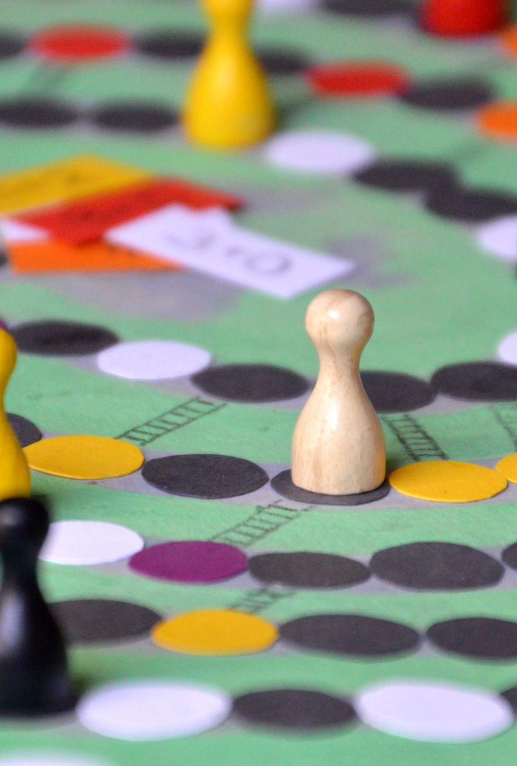
C H 5 4 3 0
Principles of Game Theory
Class 1

Slide 2

The Game Plan
Logistics
Overview
Structure
…the admin stuff
…‘what’ & ‘why’
…organization

Slide 3


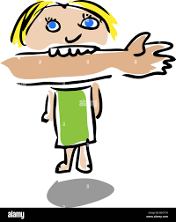
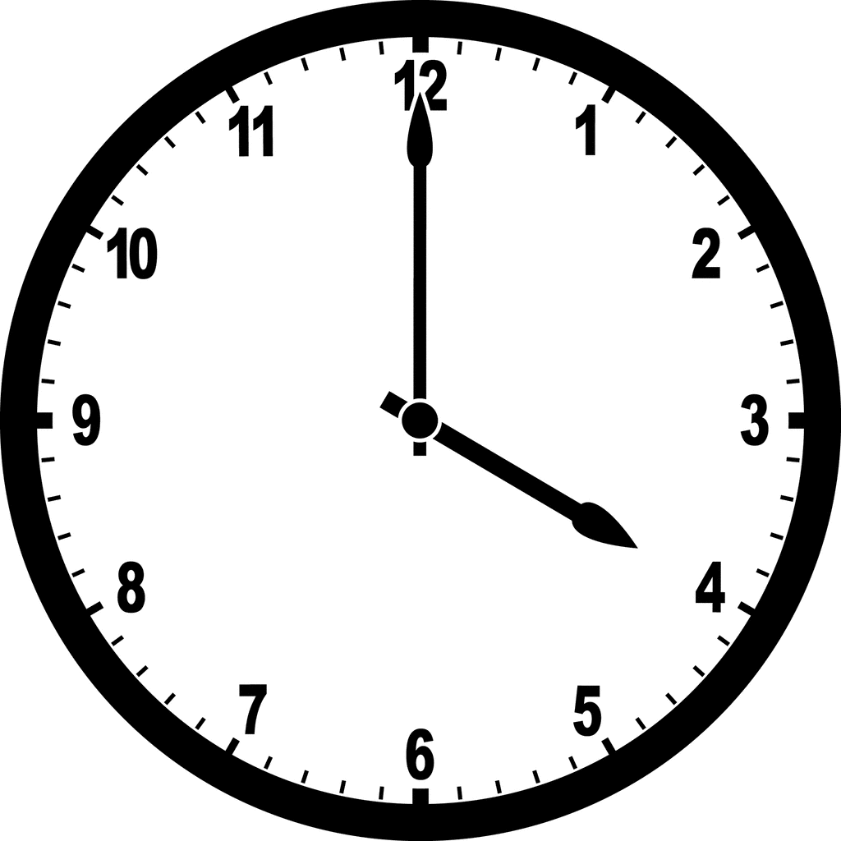
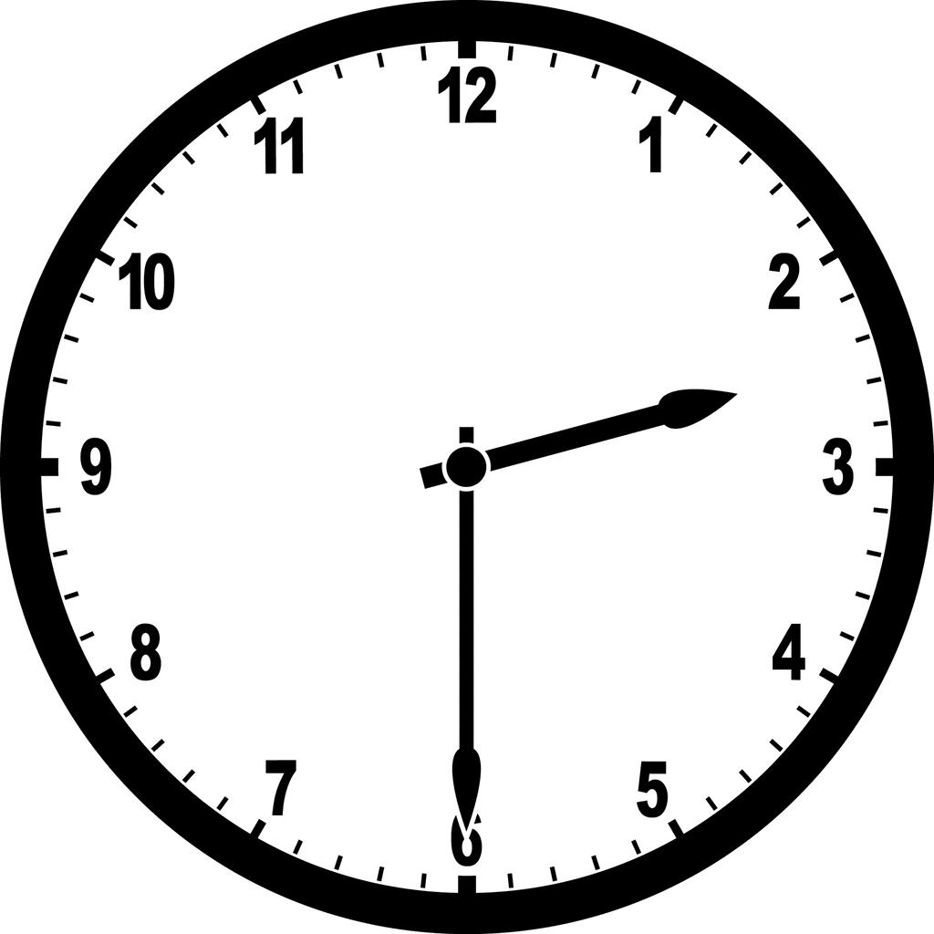
Logistics
At a Glance
Slot S CHE 119
Credits: 3
Jan 6 – Apr 24
Segments 1-6
Exams: 2 + 2 = 4
parag@che.iith.ac.in
TAs: Deepika, Sai Koushik, Asmelash

Slide 4
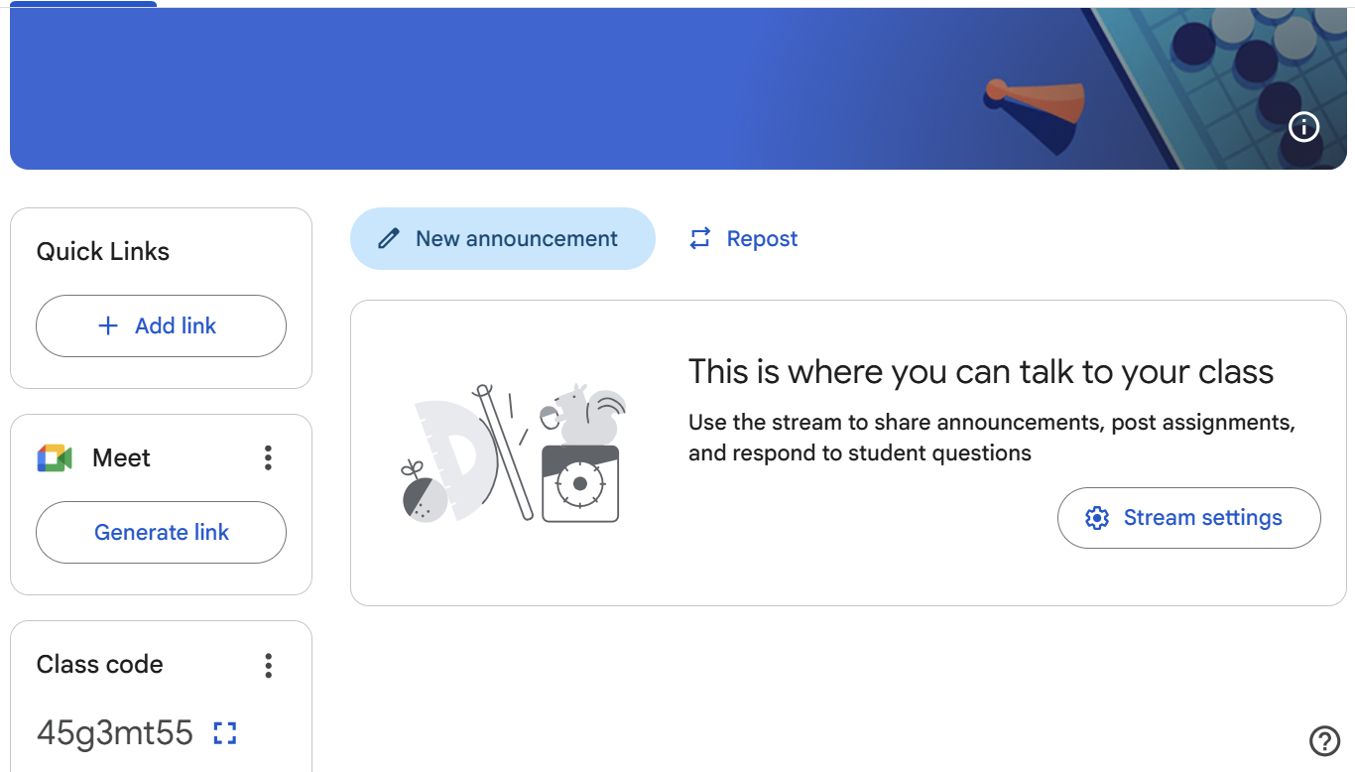


Logistics
Google Classroom
Uploaded to Google Classroom…
Slides
Announcements
Solutions to exams
Marks
Polls
PowerPoint for Microsoft 365

Slide 5

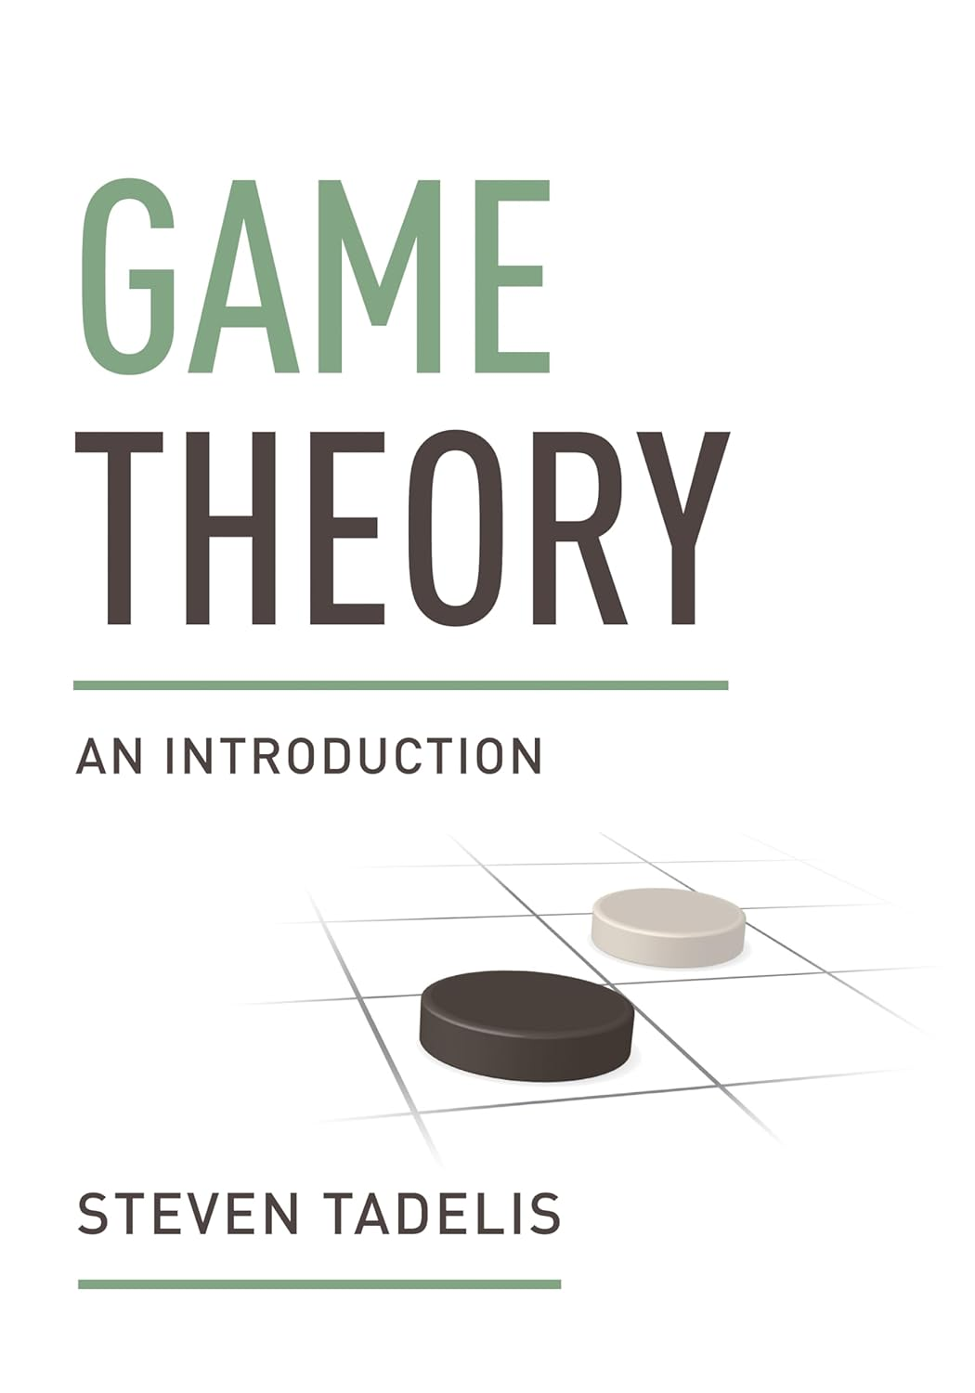
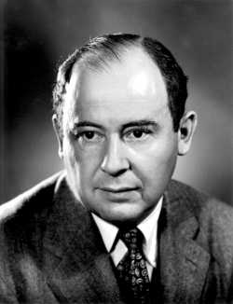
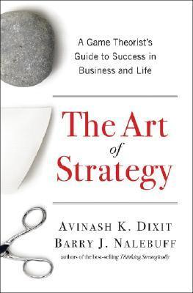
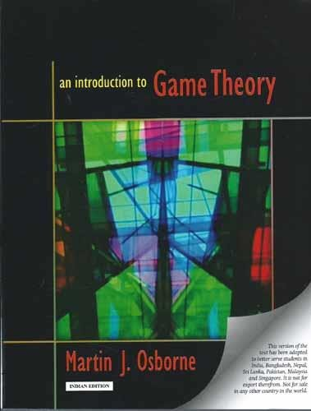
Logistics
Book
Formal but approachable
Thorough but not overwhelming
1928
Fun but fluffy
Brain-meltingly dense
A 100-year-old toddler
Not enough books
Academicians
Laypeople
John von Neumann
The problem of plenty
Lawyers
AI Researchers
Governments
Corporations
Policymakers
Environmental planners
Economists
Social Scientists
Sportsmen
Military Strategists

Slide 6

Logistics
Pre-requisites
Self-contained
Review
Sets & Sequences
Calculus & Optimization
Probability and random variables
No prior game theory assumed
Active engagement expected
Chemical Engineering
Coding

Slide 7

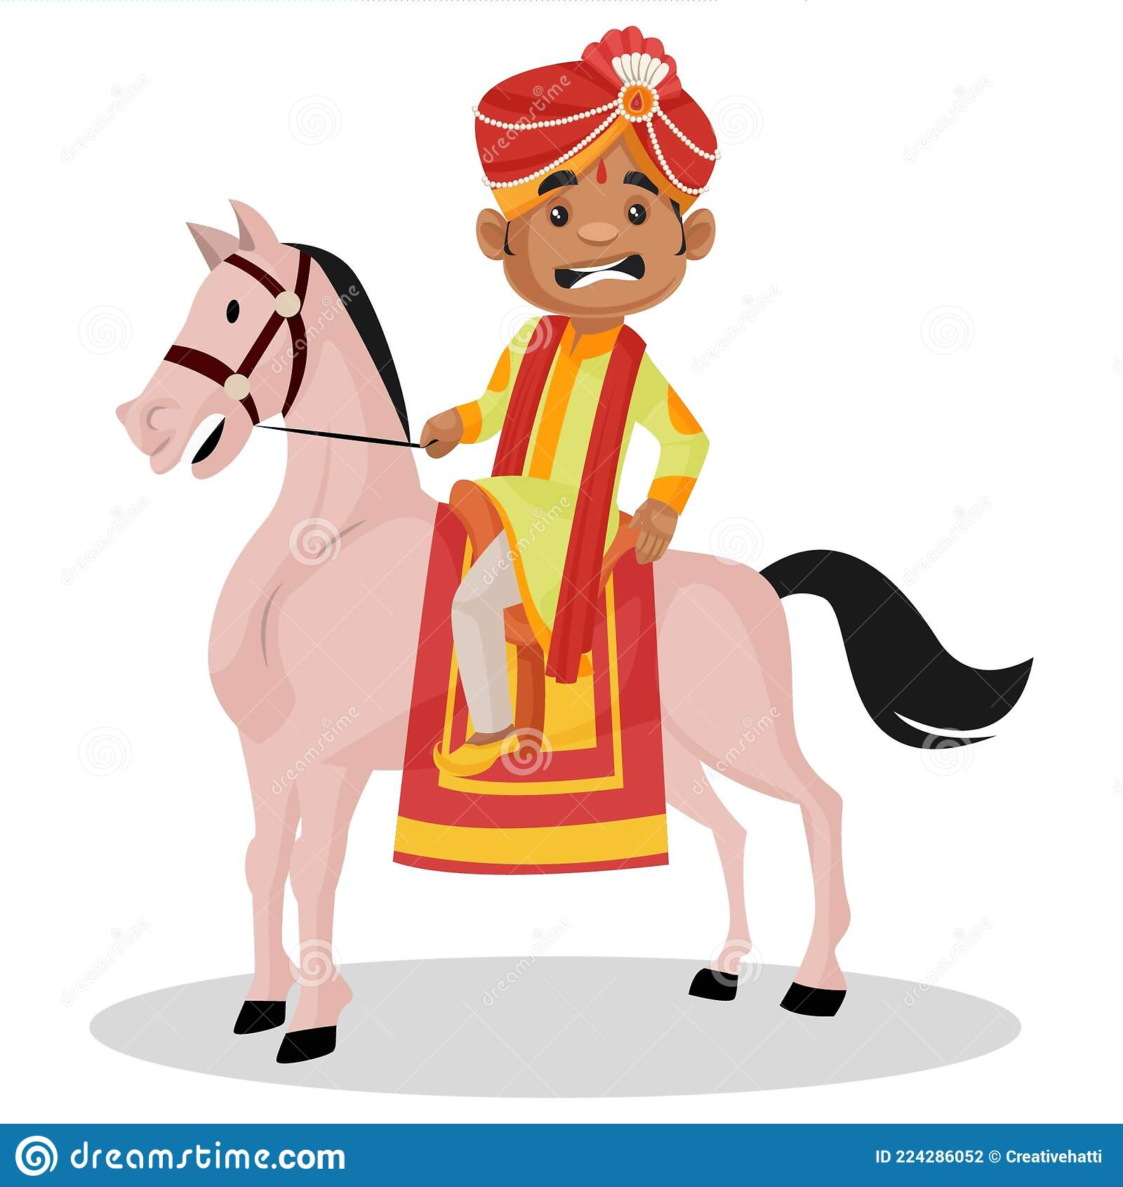


Logistics
Exams and Grading Scheme
Exam 2
April
24
Friday
2:30 – 4 PM
Focus
Problem-solving
Exam 1
February
27
Friday
2:30 – 4 PM
35%
25%
Attendance Cheat Sheet
Test 1
February
3
Tuesday
4 – 5:30 PM
Test 2
March
27
Friday
2:30 – 4 PM
Focus
Conceptual understanding
Attendance
15%
15%
10%

Slide 8
What is Game Theory?

Slide 9

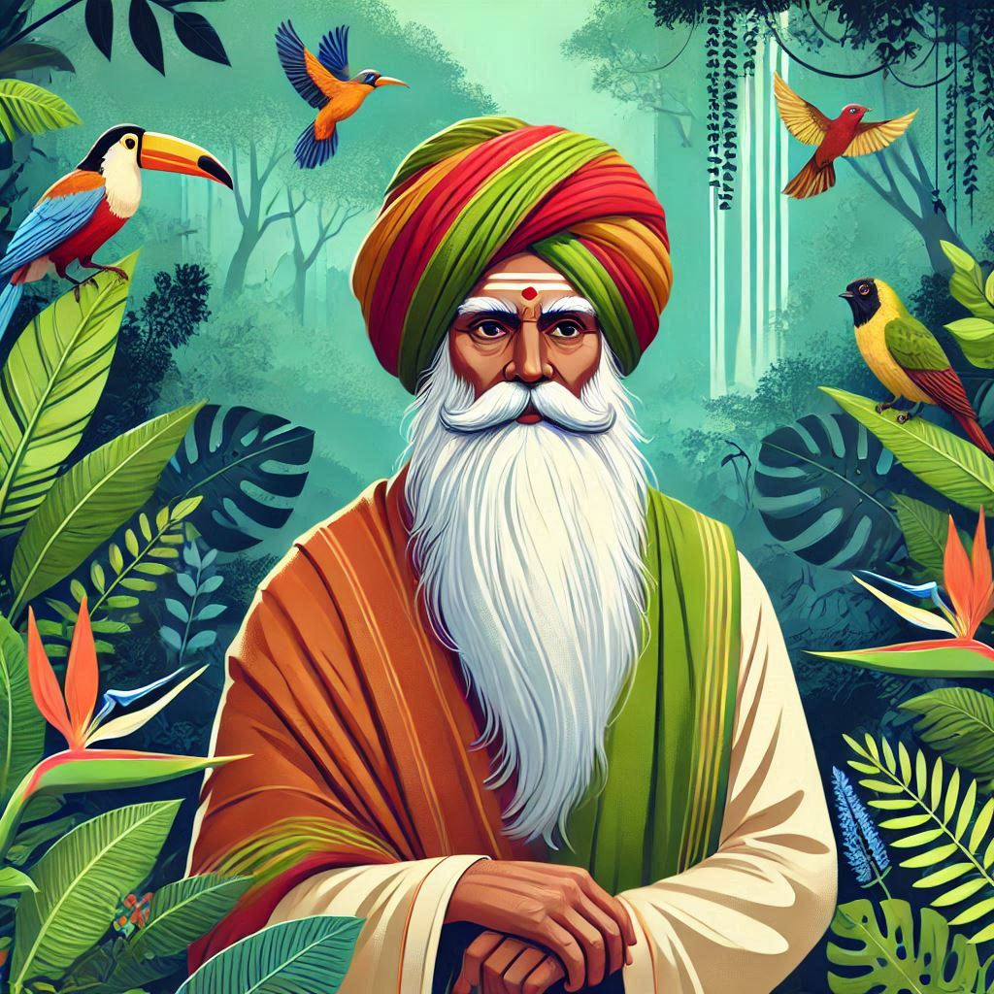
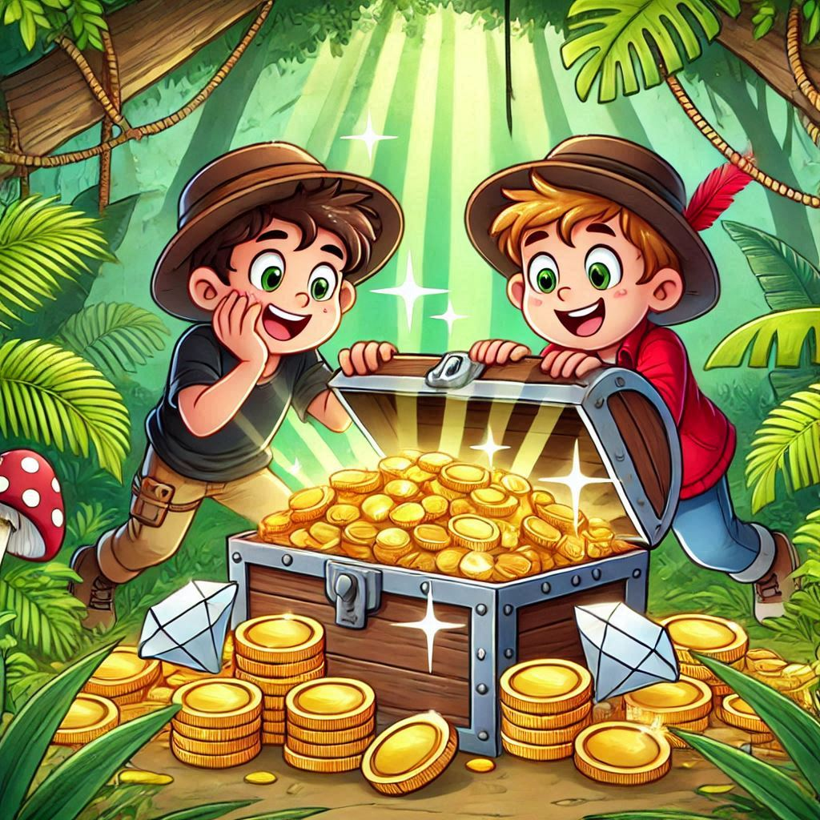
Jungle Treasure
Scenario
You and your friend stumble upon a treasure chest full of gold and diamonds in the jungle.
The Problem
Both of you claim to have seen it first and feel entitled to the treasure.
An excited and heated argument ensues with no resolution in sight.
Enter the Wise Old Man
A neutral observer offers to help resolve the conflict.
You and your friend both agree to follow the old man’s advice.

Slide 10
Jungle Treasure
The Old Man’s Proposal
The old man gives each of you a flashcard and asks you to secretly write down your decision for the treasure on the card.
You can choose to—
Write SHARE if you propose to split the treasure equally.
Write TAKE if you claim the entire treasure for yourself.
The Outcomes (…after collecting the two cards)
If both of you write SHARE, then the treasure is split equally.
If one writes SHARE and the other writes TAKE, the person who wrote TAKE gets the whole treasure, while the one who wrote SHARE gets nothing.
If both of you write TAKE, you’ll each get only a quarter of the treasure, and the wise old man keeps the remaining half.

Slide 11
Jungle Treasure
SHARE
TAKE
Google Classroom
Code: 45g3mt55
YOUR TURN
In the Google Form—
Question 1: Secretly choose SHARE or TAKE.
Question 2: Briefly explain why your choice is the better option.
Your choice will be randomly paired with a classmate’s response.
The Outcomes (…after collecting the two cards)
If both of you write SHARE, then the treasure is split equally.
If one writes SHARE and the other writes TAKE, the person who wrote TAKE gets the whole treasure, while the one who wrote SHARE gets nothing.
If both of you write TAKE, you’ll each get only a quarter of the treasure, and the wise old man keeps the remaining half.

Slide 12
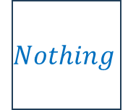
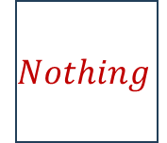






















Jungle Treasure: The Outcome Matrix
My Friend
My Friend
My Friend
$$Share$$
$$Take$$
$$S$$
$$T$$
$$Share$$
$T$ake
$$Share$$
$$Half$$
$$Nothing$$
$$S$$
$$H, H$$
$$N, W$$
$$Share$$
$$Half$$
$$Whole$$
Me
Me
Me
$$Take$$
$$Whole$$
$$Quarter$$
$$T$$
$$W, N$$
$$Q, Q$$
$$Take$$
$$Nothing$$
$$Quarter$$
My Outcomes
My Friend’s Outcomes

Slide 13
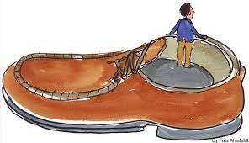








Reflections: Why Select TAKE?
Fear of the worst outcome: Picking SHARE may lead to me getting nothing. TAKE guarantees that I’ll get at least a quarter of the treasure. TAKE is the safer option.
Unilateral thinking
My Friend
…but my outcome depends on not only my own action but also that of my friend.
$$S$$
$$T$$
Hoping for the best outcome: TAKE gives me a chance to get the whole treasure.
$$S$$
$$H, H$$
$$N, W$$
Distrust: I expect my friend to choose TAKE, so choosing SHARE will leave me vulnerable.
Me
Strategic thinking
$$T$$
$$W, N$$
$$Q, Q$$
…based on expectations: what I believe my friend will do.
Lack of credibility: Even if I plan to SHARE, I don’t believe my friend trusts me to do that and will therefore choose TAKE.
The Outcome Matrix
Short-Term Gain: Valuing immediate rewards over future friendship, or moral considerations.
Time-based thinking
What if the same scenario repeats in the future?

Slide 14

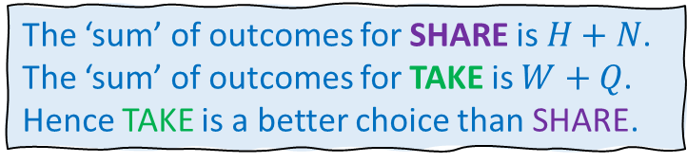
Reflections: Why Select TAKE?
The game theoretic perspective…
Strategic Thinking: No matter what my friend selects, I get a better outcome for selecting TAKE.
My Friend
$$S$$
$$T$$
Outcome ‘levels’
Whole treasure: TAKE
Half: SHARE
$$S$$
$$H, H$$
$$N, W$$
Quarter: TAKE
Nothing: SHARE
Me
The ‘sum’ of outcomes for SHARE is $H+N$.
The ‘sum’ of outcomes for TAKE is $W+Q$.
Hence TAKE is a better choice than SHARE.
$$T$$
$$W, N$$
$$Q, Q$$
What’s wrong with this argument?
…Assumption that the opponent is equally likely to select TAKE and SHARE
The Outcome Matrix
…Mixed versus Pure strategies

Slide 15
Reflections: Why Select SHARE?
Fairness: My friend and I found the treasure together. It’s only fair that we distribute it evenly between us.
My Friend
$$S$$
$$T$$
Trust: I’ve known my friend for many years. I trust him to select SHARE.
$$S$$
$$H, H$$
$$N, W$$
Valuing Friendship: I prioritize friendship and our long-term relationship over immediate personal gain.
Me
$$T$$
$$W, N$$
$$Q, Q$$
Reputation: If I don’t select SHARE, my friend think the worse of me, and my reputation will suffer.
The Outcome Matrix
Guilt: I’ll feel guilty for being selfish if I select TAKE.
Unclear about the rules
Flawed analysis
Irrational
…what else?

Slide 16


Reflections: Why Select SHARE?
Friend
Strategic empathy…
Selecting SHARE is not necessarily irrational.
…a human trait
My Friend
…a different way of valuing the four outcomes.
Behavioral game theory
$$S$$
$$T$$
Payoffs are different from outcomes.
$$S$$
$$H, H$$
$$N, W$$
How each outcome is valued
(different for different players)
Consequences of actions
(same for all players)
Me
Payoffs can be more complex, beyond just the treasure-portion.
$$T$$
$$W, N$$
$$Q, Q$$
…a larger portion of the treasure…
The Outcome Matrix
No matter what my friend selects, I get a better outcome for selecting TAKE.
Assumption: More treasure is better.

